Slide 1
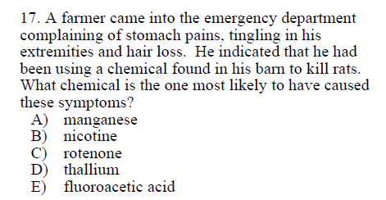

Slide 2
Manganese – childhood developmental disorders, neurodegeneration in adults
Nicotine – nausea, dizziness, other CNS effects
Rotenone – acute tox is rare because causes vomiting, dopamine neuron loss
Thallium – known rodenticide, extensive alopecia (hair loss)
Fluoroacetic acid – known rodenticide, use restricted to trained personnel, GI effects, followed by severe cardiovascular and CNS effects (agitation, convulsions, coma)
C&D 8th Chapter 22 p. 969

Slide 3
Manganese – childhood developmental disorders, neurodegeneration in adults
Nicotine – nausea, dizziness, other CNS effects
Rotenone – acute tox is rare because causes vomiting, dopamine neuron loss
Thallium – known rodenticide, extensive alopecia (hair loss)
Fluoroacetic acid – known rodenticide, use restricted to trained personnel, GI effects, followed by severe cardiovascular and CNS effects (agitation, convulsions, coma)
ANSWER: thallium
Hair loss is the key
C&D 8th Chapter 22 p. 969

Slide 4
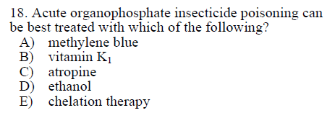

Slide 5
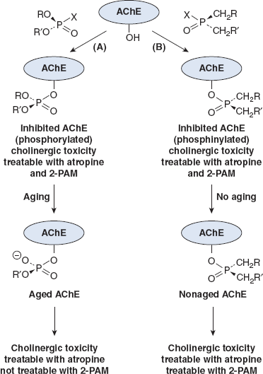
Organophosphate insecticides are probably the pesticides of most concern for acute human toxicity
OPs = cholinesterase inhibitors
Atropine = anticholinergic/antimuscarinic
2-PAM (pralidoxime) = reverses the binding of cholinesterase inhibitors with acetylcholinesterase
Aging = net loss of a ligand from the phosphorus of the OP-enzyme conjugate, leaving a negatively charged phosphoryl moiety attached to the active site
C&D 8th Chapter 16, Figure 16-5, p. 746

Slide 6
Organophosphate insecticides are probably the pesticides of most concern for acute human toxicity
OPs = cholinesterase inhibitors
Atropine = anticholinergic/antimuscarinic
2-PAM (pralidoxime) = reverses the binding of cholinesterase inhibitors with acetylcholinesterase
Aging = net loss of a ligand from the phosphorus of the OP-enzyme conjugate, leaving a negatively charged phosphoryl moiety attached to the active site
ANSWER: atropine
C&D 8th Chapter 16, Figure 16-5 p. 746

Slide 7
FYI
methylene blue – treats methemoglobinemia (requires NADPH) [p. 533]
vitamin K1 – treats anticoagulation poisoning (ex. rat poison) [p. 968]
ethanol – treats ethylene glycol poisoning (competes for alcohol dehyrdogenase) or methanol poisoning (but fomepizole preferred over ethanol)
chelation therapy – often used for metals

Slide 8
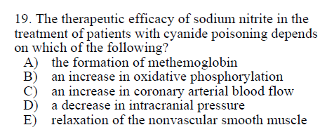

Slide 9
Nitrites interact directly with heme to oxidize heme iron -> forms methemoglobin
Methemoglobin binds free cyanide, sparing other critical enzymes
C&D 8th Chapter 11, p. 534

Slide 10
Nitrites interact directly with heme to oxidize heme iron -> forms methemoglobin
Methemoglobin binds free cyanide, sparing other critical enzymes
ANSWER: the formation of methemoglobin
C&D 8th Chapter 11, p. 534

Slide 11
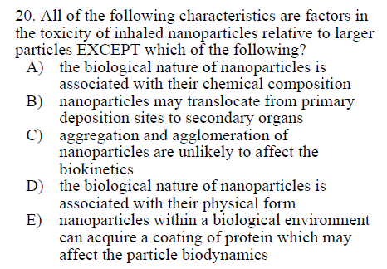

Slide 12
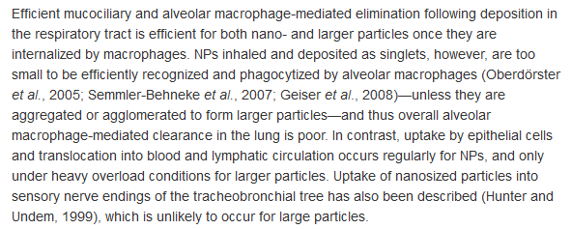
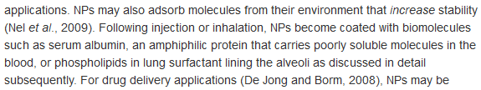

Slide 13
ANSWER: C
Aggregation and agglomeration DO affect biokinetics

Slide 14
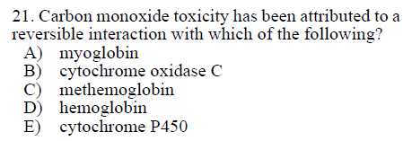

Slide 15
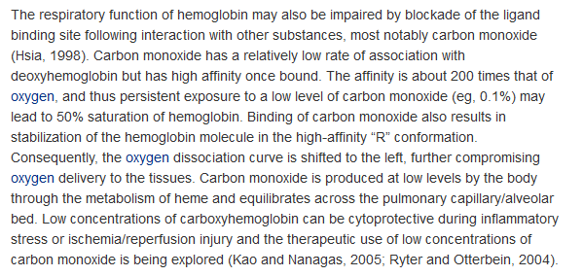
C&D 8th Chapter 11, p. 533

Slide 16
ANSWER - hemoglobin
C&D 8th Chapter 11, p. 533

Slide 17
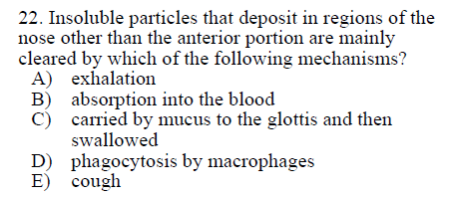

Slide 18
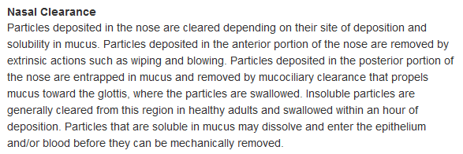
C&D 8th Chapter 15, General principles in the pathogenesis of lung damage caused by chemicals

Slide 19
ANSWER - carried by mucus to the glottis then swallowed
C&D 8th Chapter 15, General principles in the pathogenesis of lung damage caused by chemicals

Slide 20
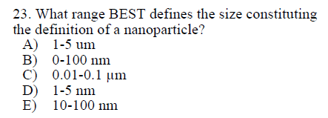

Slide 21
ANSWER - 0-100 nm

Slide 22
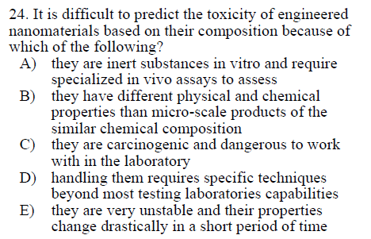

Slide 23
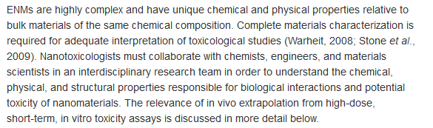

Slide 24
ANSWER: B different physical and chemical properties than microscale products

